Slide 1
Functional requirements
System should allow
1. Admin to:
Login
Change credentials
Record case
Check cases (both in the system or just reported)
Assign work to police officers
Notified of messages sent by general public
View notifications
Share data with relevant authorities
Add users(officers)
Notify officers of the duty assigned to

Slide 2
Functional requirements cont…
2. user(officers) to:
Log in
Change credentials(password)
Receive notification of the assigned work
View notifications
Report findings of assigned work
Report incident

Slide 3
Functional requirements cont…
3. User (general public) to:
Register
Log in
Change password
Report case

Slide 4
Non functional requirements
System should be
Effective
Efficient
Secure
User friendly

Slide 5
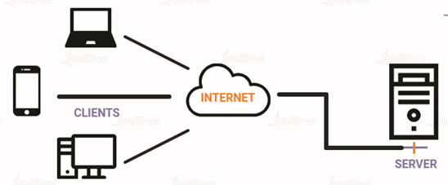
System architecture(client-server)
Officer
Public user
Admin

Slide 6
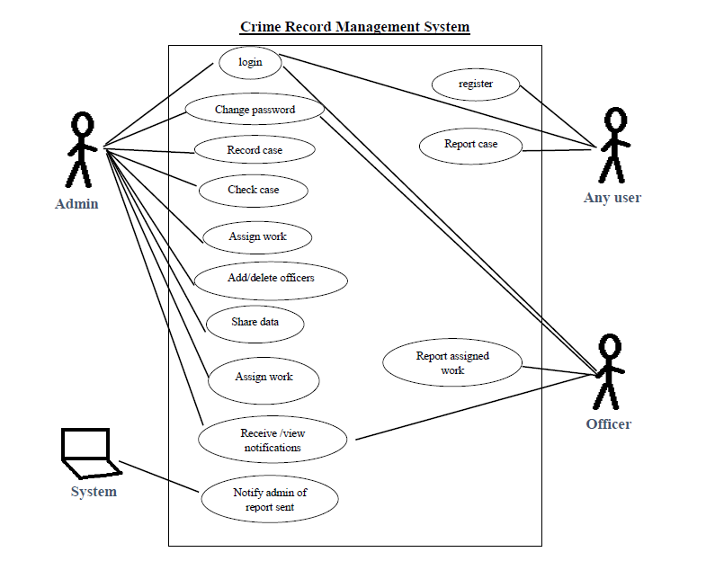
Use case

